Slide 1

Virtual Hawk
Sonia Rivas
Raymond Ezekiel
Bryan Castillo
Mohamad Abu-Rezeq
James Dumitru

Slide 2
IIT MAIN CAMPUS
120 Acres
Spans across 5 blocks
18 Academic and Student Services buildings
7 Greek Life buildings
https://www.iit.edu/about/campus-information/mies-campus/mies-campus-buildings
Notes:
Start off with as you know might already know...

Slide 3
Here’s the scene...
You’re new to IIT and you have a place in mind, but don’t know where to go…
You’re stuck and need to pull up an actual photo of the map because the map on google is only limited to buildings.
You’re trying to find information on today’s Debate Club meeting on the website but there doesn’t seem to be any updated information there.

Slide 4
Problem with other Apps
Not precise enough
Not specific to IIT and its campus
Lacking information in an “all-in-one”place
Notes:
Like google maps or the map that IIT offers, it’s too limited
Another thing to look out for is that information is in multiple places so you have to jump from and fro for that.

Slide 5
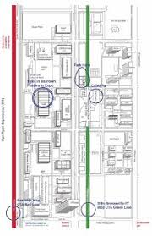
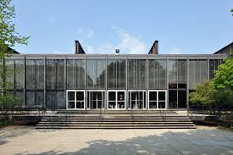

“IIT is a large campus. If you’d like to get any things done in-between classes, you’d better know exactly where things are. MTCC houses a lot of services and finding what you are looking for can be difficult. To reach certain offices on campus such as the Access, Card, and Parking Services on the 2nd floor of Hermann, you’d better have a map!”
-- Kevin, '21

Slide 6
“I wish there was an easier way to find out about events and club meetings. Some posters on the bulletin board are outdated and I either forget about an event or see an announcement after it happened! It would be cool to have an app to let me know when and where these activities are happening, so I can find something to do in between classes.”
-- Sam, '21

Slide 7
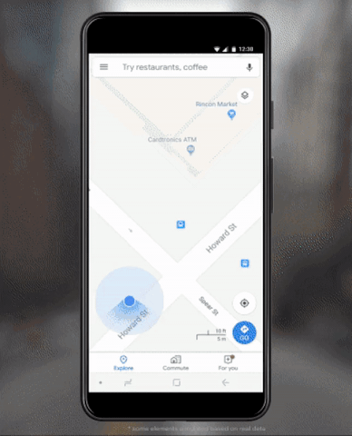
So what’s the solution?
Virtual Hawk

Slide 8

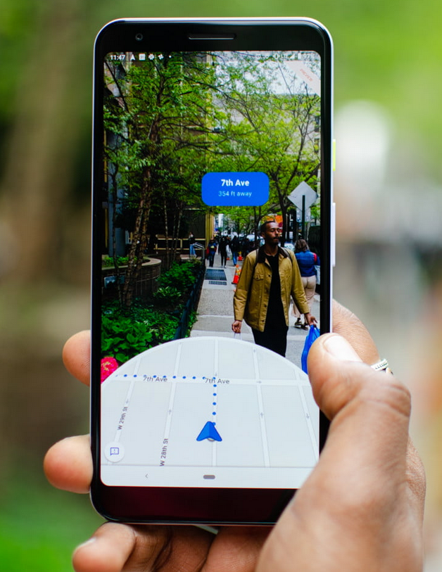
What is Virtual Hawk?
Virtual Hawk is a campus connectivity Webapp that provides users with navigational tools and up-to-date information on campus buildings, location of services, and events happening on campus.
Notes:
app or website?

Slide 9
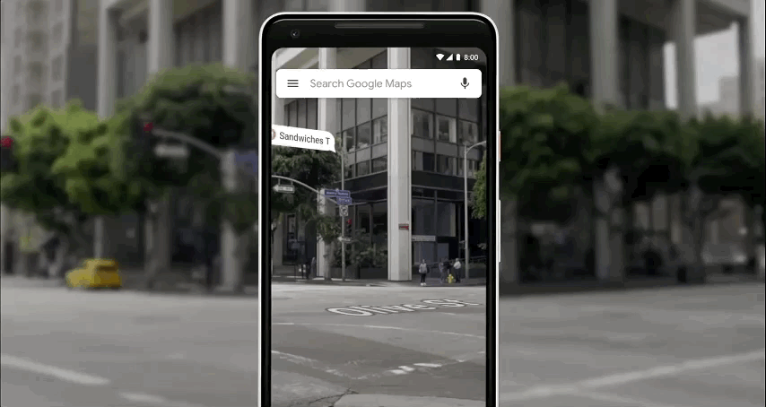
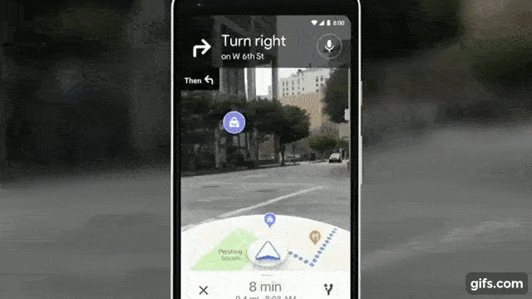
Real-Time Events as you walk
Building Info/Events
Access to what’s going on
Shows what’s near as well
AR technology shows data about IIT buildings
Clearer navigation to your destination
Already interacts with Google account
Student organizations & Clubs details are shown
Live Navigation

Slide 10

So Billy can always find his way!

Slide 11
Thank you for your time!
Please feel free to reach out to us if you have any Questions, Comments, Concerns.
srivas@hawk.iit.edu - Sonia Rivas
maburezeq@hawk.iit.edu - Mohammed Aburezeq
rezekiel@hawk.iit.edu - Raymond Ezekiel
jdumitru@hawk.iit.edu - James Dumitru
bcruzcastillo@hawk.iit.edu - Bryan Castillo
https://virtual-hawk.github.io/Virtual-Hawk/index.html

